Slide 1
Prestige Insurance Renewal Insights:
Where to from here?
Mech Simmer
Notes:
Hey Everyone – to kick off I wanted to share an interesting study - A study by Mckinsey and Company who found that data driven organizations are 23 times more likely to outperform there competitors, and 19 times more likely to be profitable – this is the power of weaving data into our decisions – So, as we go through the insights today, let's bear that in mind

Slide 2
23X
19X
To outperform competitors
To be profitable
Notes:
Hi Everyone – to kick off I wanted to share an interesting study - A study by Mckinsey and Company who found that data driven organizations are 23 times more likely to outperform there competitors, and 19 times more likely to be profitable – this is the impact of connecting data in decision making – So, as we go through the insights today, let's bear that in mind

Slide 3
Date
Covers 5 days
Brand
10 brands
Channel
6 Channels
Call Centre, Online, Dealer, Agency, Cross Sell, Bank Branch
Renewal Transaction Count
Renewal Units
Gross Written Premium (GWP)
A, B , C, D, E, F, G, H, I, J
Products
Motor, Home, Motorcycle, Boat, Caravan, Trailer, Relocatable Home & MotorHome
Notes:
I wanted to give a quick background on the dataset – it covers a short period of 5 days of renewal transactions, renewal units & gross premiums for a number of brands, products and renewal channel. The aim was to utilise this data to understand current market dynamics, to remain innovative & competitive in the insurance industry, and then used to inform business decisions. By the end of this presentation Prestige insurance will have a new guiding strategy.

Slide 4
Renewal Channel Analysis
Not Online
Online
Unknown
Notes:
So as we delve into our renewal channels, Our stats tell an interesting story: a substantial 71% of our renewal activity transpire through offline channels such as; our call centre’s, agencies, bank branches and dealers (just to name a few) while only 25%, are completed via online channels., and finally the rest remains unknown due to data collection issues.
This is visually captured in these charts.

Slide 5
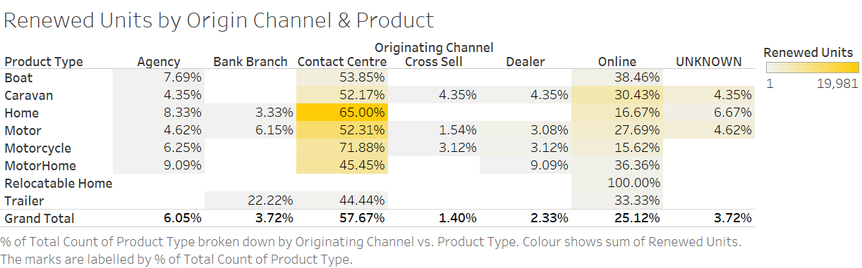
Renewal Channel Analysis
Notes:
But what does this signify? At first glance, it suggests a customer inclination towards personal interaction—our customers seem to favor a voice on the line or face to face interaction, reassuring and guiding them through there renewal.
The data also reflects a diversity in customer preference for channels based on the type of product - For example relocatable home is managed purely online.
With online channels coming in as second best there may be opportunities to improve or capitalise on this.
But there is another layer to consider—a potential shortfall in our digital experience. This leads us to question - Is our online platform user friendly and intuitive?
Understanding this breakdown can help us rethink our online presence to be not just accessible, but also as engaging and smooth as our offline service channels provide

Slide 6
Brand Performance
Top Performers
Bottom Performers
$18.1M
$15.4M
$13.2M
$44.8K
$246
Brand E
Brand F
Brand C
Brand H
Brand J
Notes:
Shifting focus to brand performance – it's clear which brands are ahead and which ones are lagging. Brands F, C & E are the top performers for major premium contributions, while J & H were lower in there premium contributions.

Slide 7
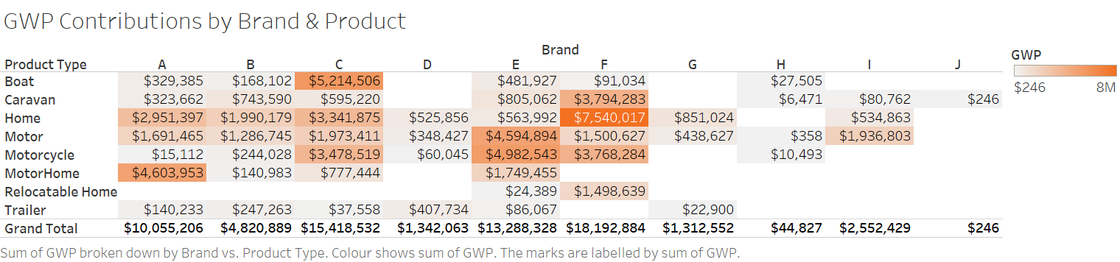
Brand Performance
Notes:
With a deeper look its evident that some products are performing better under different brands, and others are not offered at all (we can see this for majority of brand J).
So major call outs:
Brand A stands out for motorhome, C for boat, E for Motor and Motorcycle, and F is dominating Home.
The connection between the brand and high performing products can indicate; a steady & reliable product, and a strong product to brand fit that resonates with our customers On the other hand, brands with lower premiums could signal a misalignment – maybe policy features aren’t resonating, or there is a need to understand these customers better, perhaps some products have specific peaks, such as Boat or Caravan so less premiums are coming in It's clear based on what we’ve just discussed, to transform these insights into actions there are still a few “why” questions to be answered.

Slide 8
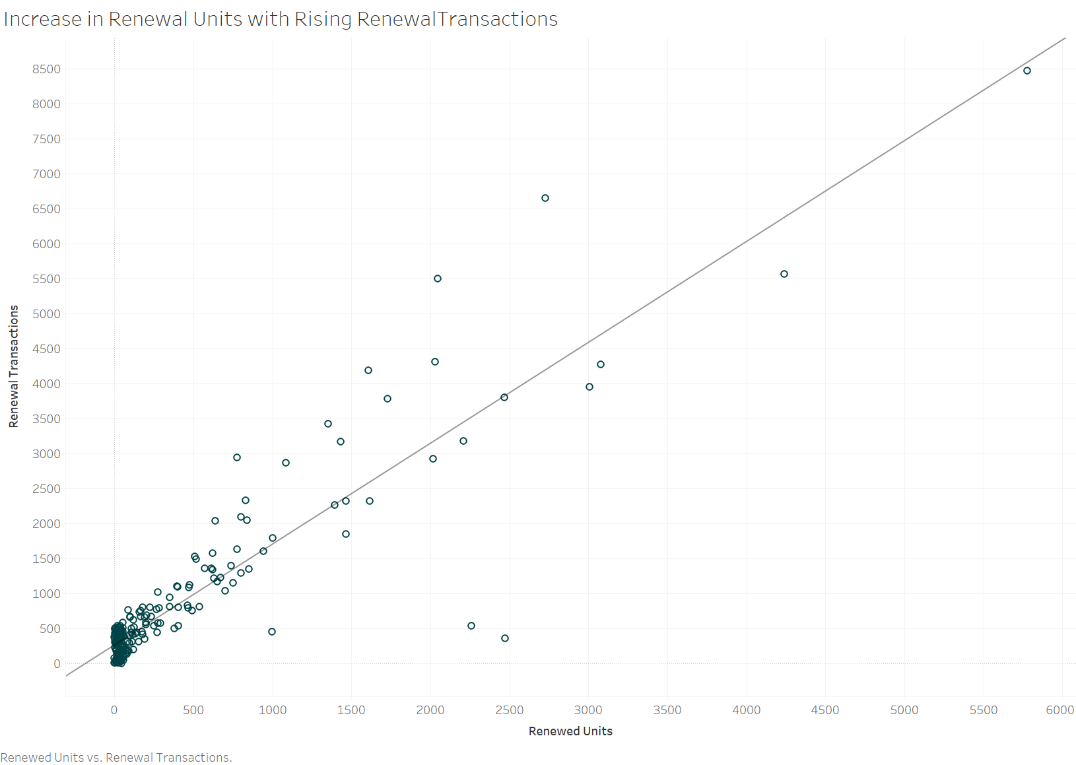
Transactions & Renewed Units
Notes:
Now this was a really interesting insight – But let's clear up a couple of terms first. "Renewal units" are the count of policies or the items covered by a policy. “Renewal transactions" are the updates or changes made to those policies, whether it's through a phone call, an email, or online.
The chart you are looking at shows an increase in renewal units with rising renewal transactions. So what does this trend suggest? the more a customer engages with us—be it online or over the phone concerning their policy—the higher the chances they'll renew their policy
Now there is a lot to unpack when looking at this relationship, and the data in this dataset only provided a glimpse into it. We need understand the reason behind this? Are customers just satisfied with our services, is our pricing simply competitive, or are they happy with our loyalty program.
To validate and solidify these findings further analysis will need to be conducted

Slide 9
Data Collection
Data Analysis
Business Strategy
Informed Decisions
Notes:
With these preliminary insights, it's evident that there's more work to be done. We require additional data to make more informed decisions and develop effective strategies. Expanding the timeframe for our analysis is crucial to attain more comprehensive & robust insights
This is particularly important when it comes to understanding long-term trends, seasonal variations, and delving deeper into customer behaviors. To achieve this, I propose a comprehensive approach that involves collecting a larger and more diverse dataset. This means gathering additional data, including customer satisfaction scores (Net Promoter Score or NPS), customer demographics, detailed policy information, complaints data, and conducting a thorough analysis of our competitors.
Enriching our dataset will empower us to make better-informed decisions that can drive our growth and help us maintain a competitive edge in the market. This forward-thinking approach is key to keeping our business thriving and relevant as the market continues to change

